Slide 2
Updates in the Management of Drug-Susceptible TB in People Living with HIV
Patrice Severe, MD, MPH
Les Centres GHESKIO
Port-au-Prince, Haiti
Notes:
First off I want to thank the organizers for inviting me to be part of this conference.
Today I will briefly present on selected recent updates on drug susceptible TB in people living with HIV

Slide 3
Updates in Management of Drug-Susceptible TB in PLWHIV
Diagnosis
Prevention
Treatment
Update on TB Vaccines
Notes:
I will go over updates in Diagnosis, Prevention and Treatment of TB with a brief mention on upcoming TB vaccines

Slide 4
Why is TB Still Relevant Today?
Worldwide, 10 million new incident cases of TB in 2017; 1.6 million TB deaths
464,633 of incident TB cases (9%) were in people with HIV; 300,000 HIV-TB deaths in 2017 (18.8%)
Notes:
In 2017, there were more than 10 millions new cases of TB and 1.6 million deaths (that’s more than HIV related deaths)
In people living with HIV, TB mortality is still close to 20%

Slide 5
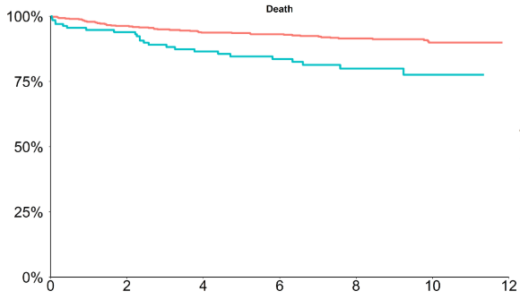
Higher Long-Term Mortality in TB Survivors (vs. No TB)
No-TB cohort
TB cohort
Log-rank p<0.001
Survival probability (%)
Time (years)
Note: Time “0” was 8-months post TB diagnosis (for TB cohort) and 8 months after enrollment (for no-TB cohort).
Patients at risk:
Yvetot J, et al. CROI 2019
Notes:
In a recent retrospective study presented at CROI this year, patients with HIV who are TB survivors have higher long-term mortality compared to patients without TB.
At 12 years after enrollment in the study, we see significantly lower survival rates in the TB cohort as shown by the blue curve.

Slide 6
Updates in TB Diagnosis
.
Notes:
What are the latest updates in diagnosis of TB?

Slide 7
TB Detection with Xpert vs Xpert Ultra
 | Sensitivity By Smear and HIV Status (95% CI; n/N) |  |  |  | Specificity (95% CI; n/N)
 | All culture-positive | Smear-negative | HIV-negative | HIV-positive | All culture-positive
Xpert | 83% (79-86; 383/462) | 46% (37-55; 63/137) | 90% (84-94; 143/159) | 77% (68-84; 88/155) | 98% (97-99; 960/977)
Xpert Ultra | 88% (85-91; 408/462) | 63% (54-71; 86/137) | 91% (86-95; 145/159) | 90% (83-95; 103/115) | 96% (94-97; 934/977)
Difference (Ultra minus Xpert) | 5.4% (3.3-8.0; 25/162) | 17% (10-24; 23/137) | 1.3% (-1.8-4.9; 2/159) | 13% (6.4-21; 15/115) | -2.7% (-3.9 -1.7; 36/977)
Xpert Ultra is more sensitive than Xpert in smear-negative and PLWH
Xpert Ultra has slight decrease in specificity (detection of MTB DNA from dead bacilli in patients w/hx of treated TB)
Xpert Ultra and Xpert perform similarly in detecting rifampin resistance (sensitivity 95%, specificity 98%)
Dorman S et al. Lancet Infect Dis 2018;18:76-84
Notes:
Among TB diagnostic tests available, there is a new Xpert test called the Xpert Ultra that has increased sensitivity particularly for smear negative patients and PLWH.
However, we still need point of care test for TB detection.

Slide 8
LAM Urine Test – STAMP Trial
Hospitalized adult PLWHIV in Malawi and South Africa
Systematic TB screen with sputum Xpert + urine Xpert + urine LAM vs SOC (sputum Xpert)
Reduction in mortality in 3 high-risk sub-groups:
  CD4 count <100 cells/mm³ (aRD**: -7.1%; p=0.036)
  Severe anemia (-9.0%; p=0.021)
  Clinically suspected TB (-5.7%; p=0.033)
* LAM – lipoarabinomannan urine test; **Adjusted risk reduction
Gupta-Wright A, et al. Lancet 2018; 392:10144:292-301.
Notes:
The STAMP trial looked at the urine LAM test to decrease inpatient mortality.
They found that systematically screening patients with urine LAM was associated with reduced mortality in 3 high risk subgroups: Low CD4 count, severely anemic patients, and patients with clinically suspected TB.
Although more and more patients are presenting with high CD4 counts globally, this test is important for patients with low CD4 count. However this test still has poor yield in children.

Slide 9
Updates in TB Prevention
.
Notes:
So how are we doing for the prevention of drug susceptible TB?

Slide 10
How effective are we at treating LTBI?
Slide courtesy of Constance Benson, MD
Alsdurg H, et al. Lancet Inf Dis 2016
Notes:
Here we can begin looking at prevention by treatment of LTBI.
In this cascade, we can see that less than 20% of all candidates for screening are completing LTBI treatment.
Part of this is due to the burden of taking meds for 6-9 months.
New regimens that are much shorter should help improve completion rates.

Slide 11
BRIEF-TB (ACTG 5279) – 1HP vs 9H
Compared 1 month of daily INH + rifapentine (1HP) to 9 months of INH (9H) in adolescents/adults living with HIV to see if would be non-inferior in preventing TB
1HP was found to be non-inferior to 9H for preventing TB, TB death, or death from unknown cause
1HP provides a highly-effective, ultra-short course regimen for preventing TB in PLWH
HOWEVER:
  Availability and Cost??
  Needs to be evaluated in vulnerable populations: Pregnant women, children?
Swindells S et al. N Engl J Med 2019;380:1001-1011
Notes:
This 1HP regimen was noninferior for preventing TB, TB death, or death from unknown cause in adolescents/adults living with hiv. It provides an ultra short treatment option for preventing TB in PLWH.
However, nonavailability of rifapentine remains a major problem. Key questions would be if rifapentine is available in certain countries and at what cost?
The IMPAACT network is planning studies to evaluate 1HP in pregnant women and children. It is crucial that we consider other treatment options for these populations.

Slide 12
TB Prevention in Pregnant Women?
WHO guidelines recommend INH for all PLWH, including pregnant women. Limited data avaialble
IMPAACT P1078: First phase IV multicenter, randomized, double-blind, placebo-controlled, clinical trial
HIV-infected pregnant women living in a high TB burden area
Compared INH prophylaxis initiated during pregnancy versus 3 months postpartum
Gupta A, et al. CROI 2018
Notes:
A Phase IV Randomized Double Blind Placebo-controlled Trial to evaluate the safety of IMMEDIATE (antepartum-initiated) versus DEFERRED (postpartum initiated ) Isoniazid preventative therapy among HIV-infected women in high TB incidence settings

Slide 13
IMPAACT P1078 – is INH safe in Pregnancy?
Higher than expected adverse events in both arms
Unclear if related to INH, more analysis and studies needed
These surprising findings remind us of the importance of clinical trials in vulnerable groups
Current WHO guidelines of IPT in pregnancy for HIV-infected women need re-evaluation weighing the risks and benefits
Gupta A, et al. CROI 2018

Slide 14
Prednisone for IRIS Prevention: PredART Study
Placebo-controlled RCT to assess if prednisone can prevent TB-IRIS
PLWH with CD4 count <100 cells/mm³ who started TB treatment within 30 days before initiating ART
Primary endpoint: TB-IRIS within 12 weeks after ART initiation
Results: TB-IRIS in 32.5% of prednisone group vs 46.7% of placebo
Conclusions: Prednisone reduced incidence of TB IRIS, without increased risk of severe infections or cancers
Meintjes G et al. N Engl J Med 2018; 379:1915-25
Notes:
The prevention of IRIS remains an important topic for patients living with HIV, particularly with patients with low CD4 counts. The PredART study evaluated the use of prednisone to prevent IRIS. The study findings were published in the New England Journal of Medicine in 2018 and concluded that prednisone reduced incidence of TB IRIS, with 33% incidence in the prednisone group compared to 47% in the placebo group.

Slide 15
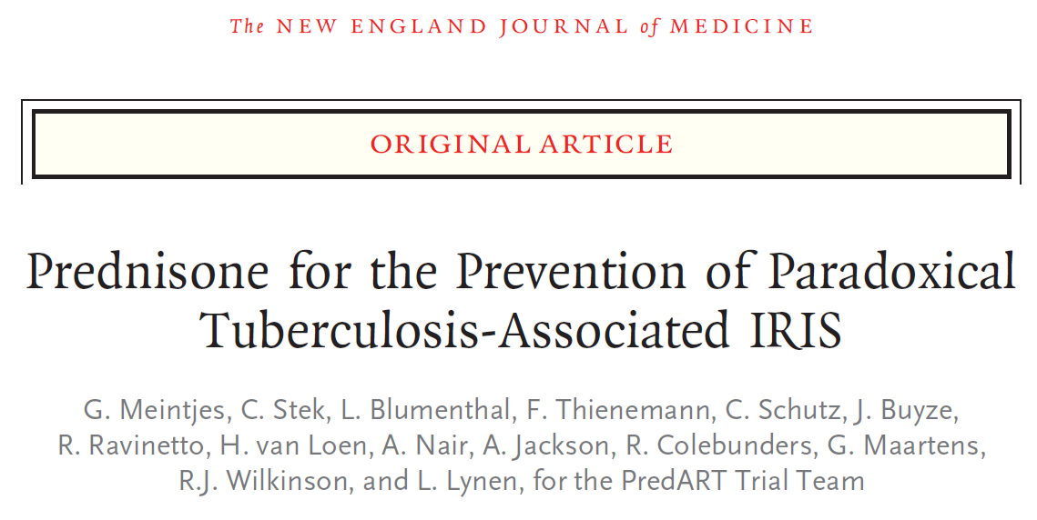
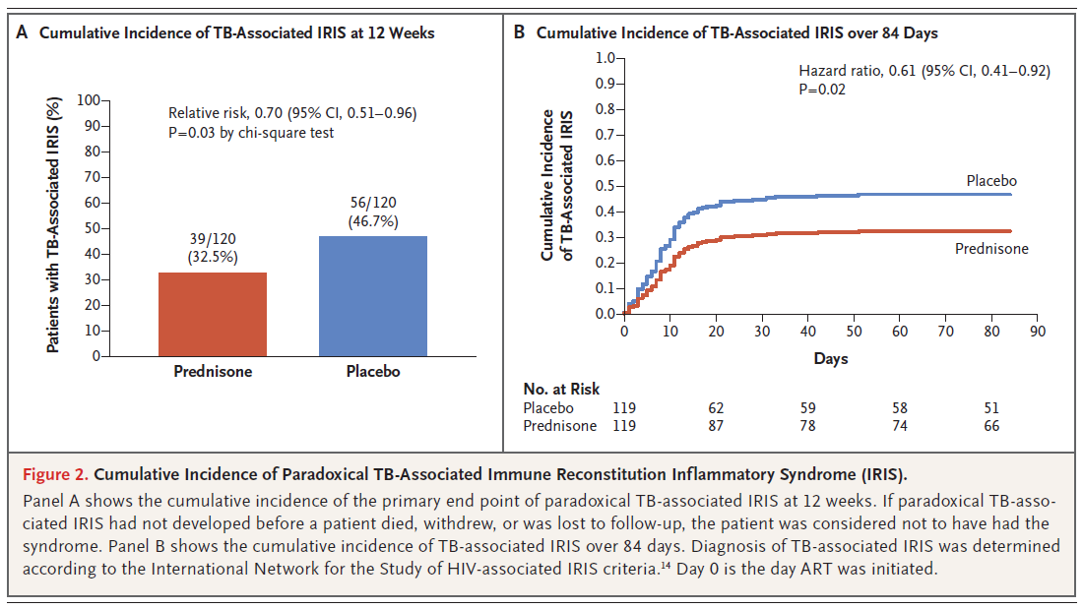
Notes:
This slide shows the reduced mortality in the group treated with prednisone (red line) compared to placebo (blue line)

Slide 16
Updates on TB Treatment
.
Notes:
Next we will look at updates in the treatment of HIV-TB coinfection.

Slide 17
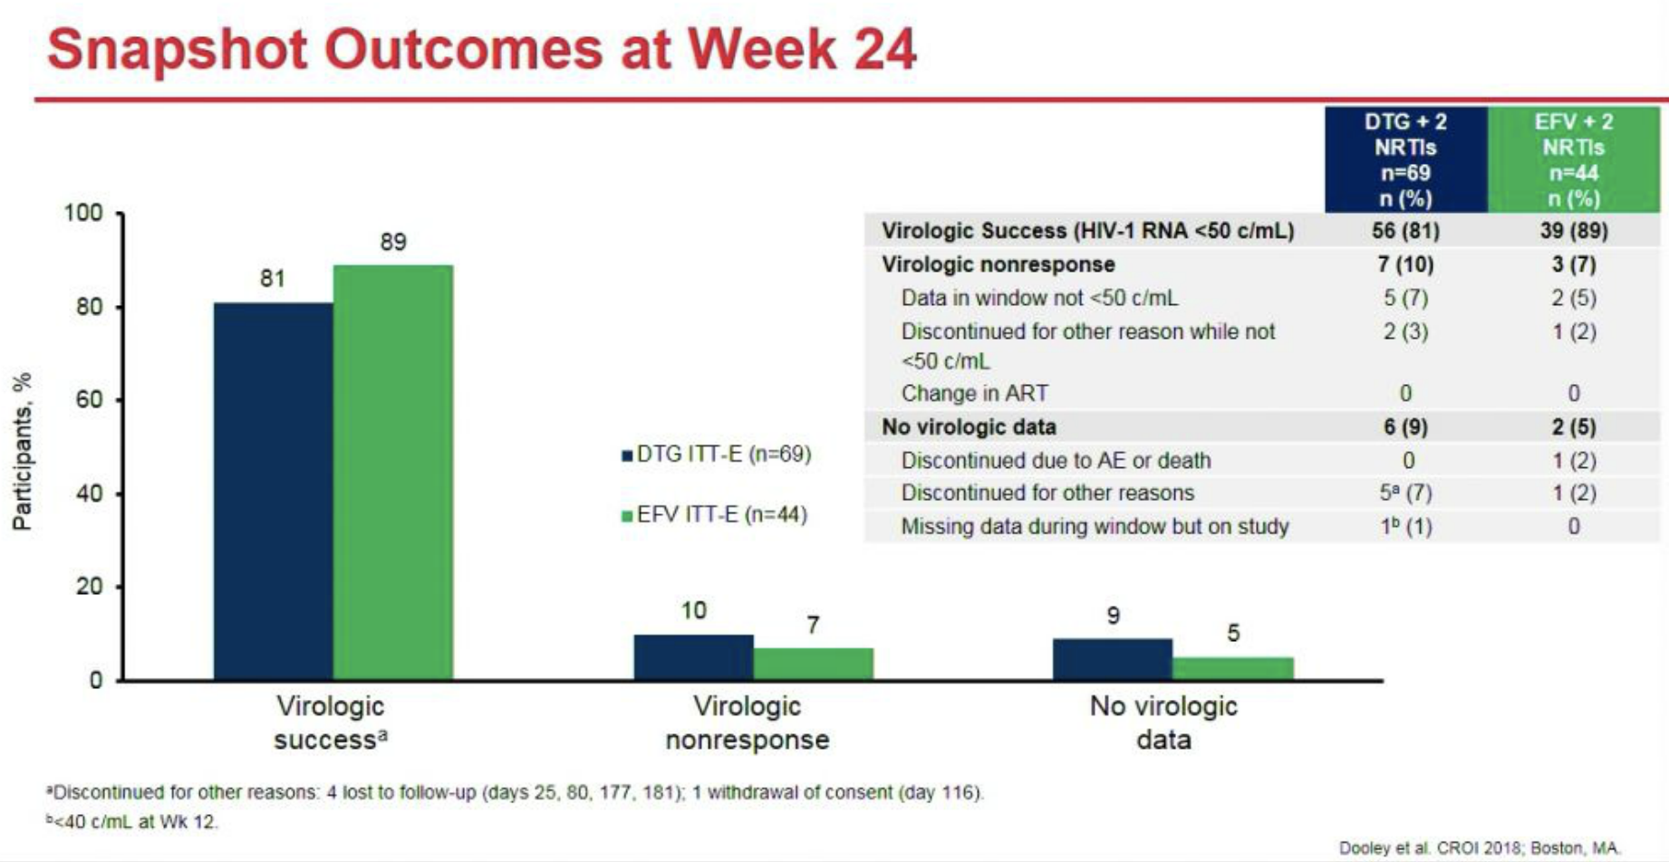
EFV vs DTG ART for HIV-TB Co-Treatment
INSPIRING Study: Phase 3b, randomized clinical trial in HIV-1 infected ART naïve adults with drug sensitive TB
Slide courtesy of Constance Benson, MD
Dooley K, et al. CROI 2018; Abstr. 33
Notes:
There are limited drugs available for treatment of TB-HIV coinfection. The INSPIRING study was an important study that evaluated the use DTG with Rifampicin based TB treatment. The study found comparable outcomes between DTG double dose and EFV treatments.
For the first time, DTG is being made available to all PEPFAR countries. This will allow for faster viral suppression 2-3x times sooner than before. This can also be used in settings where rates of TB are high to treat those who are co-infected.

Slide 18
Virologic efficacy of raltegravir vs. efavirenz based antiretroviral treatment in HIV1-infected adults with tuberculosis
W48 results of the ANRS 12300 Reflate TB2 trial
N. De Castro¹, O. Marcy², C. Chazallon², E. Messou³, S. Eholie⁴, N. Bhatt⁵, C. Khosa⁵, D. Laureillard⁶,
G. Do Chau⁷, V. Veloso⁸, C. Delaugerre^{1,9}, X. Anglaret², JM. Molina^{1,9}, B. Grinsztejn⁸
for the ANRS 12300 Reflate TB2 study group
¹ AP-HP-Hôpital Saint-Louis, Paris, France, ²University of Bordeaux, Bordeaux Population Health Centre Inserm U1219, Bordeaux, France, ³CEPREF, Abidjan, Cote D'Ivoire, ⁴SMIT, Abidjan, Cote D'Ivoire, ⁵Instituto Nacional de Saúde, Maracuene, Mozambique, ⁶CHU de Nîmes, Nîmes, France, ⁷Pham Ngoc Thach Hospital, Ho Chi Minh City, Vietnam, ⁸Laboratory of Clinical Research on STD/AIDS, IPEC, Fiocruz, Rio de Janeiro, Brazil, ⁹Université de Paris
De Castro et al. 10th IAS conference. Mexico. Slides MOAB0101

Slide 19
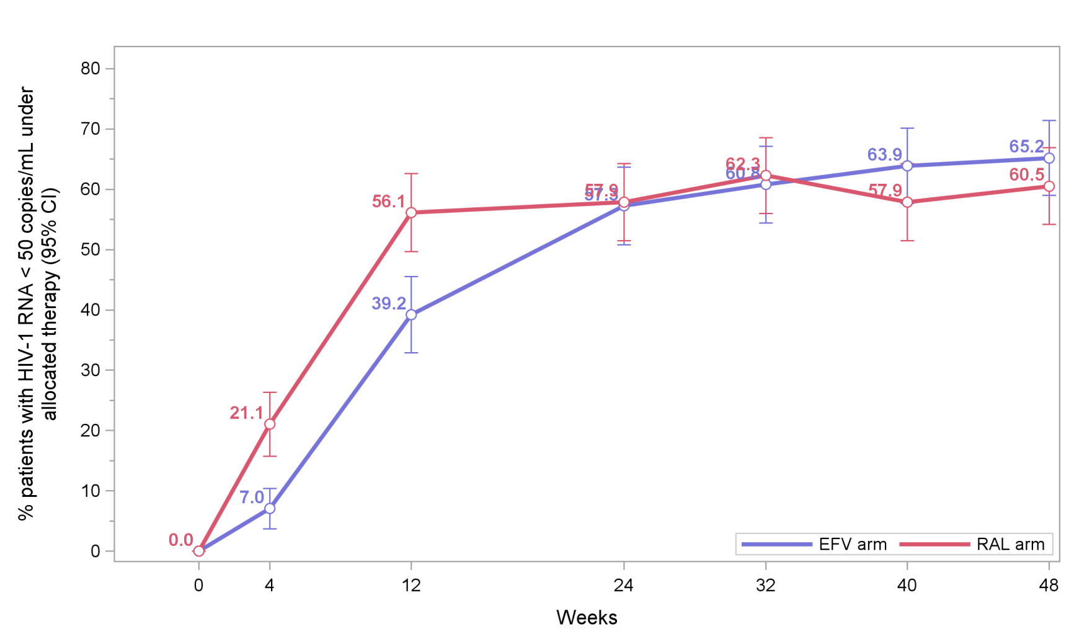
HIV RNA<50 copies/mL under allocated therapy - ITT
Viral suppression rates similar at completion of TB treatment (W24), but at W48, RAL not demonstrated to be non-inferior
EFV 57.3% (95% IC 50.8-63.7)
RAL 57.9% (95% IC 51.5-64.3)
10
De Castro et al. 10th IAS conference. Mexico. Slides MOAB0101

Slide 20
Research Priority: Develop New Regimens to Shorten TB Treatment Duration
Notes:
Our research priority for TB treatment going forward will be to develop shorter treatment regimens. This slide shows an overview of the pipeline for new drugs and regimens.
We are moving in the right direction for MDR-TB but we need new trials to shorten the 6 month course for drug sensitive TB.
Need better drugs for children, particularly to determine proper doses
Which populations can we safely give shorter regimens? Without increasing risk of relapse.

Slide 21
Updates in TB Vaccines
.
Notes:
Lastly, a brief mention on TB vaccines.

Slide 22
Vaccine Prevention of Tuberculosis
Slide courtesy of Constance Benson, MD
WHO Global Tuberculosis Report 2018
Notes:
this slide shows new vaccines being investigated for both treatment and prevention of TB.

Slide 23
Implications for Future Research and Programmatic Implementation Strategies
TB remains under-diagnosed in PLWH
  Long term survival is decreased in people treated for TB. Need more studies.
  Cheaper, faster, simpler, more sensitive diagnostic tests still needed
Prevention
  How will 1HP be scaled up?
  How to procure rifapentine for RLS?
  Need to consider pregnant women and children
  What are implications for long-term follow-up and re-infection in high-burden settings?
Treatment
  What will be the optimal shorter treatment regimen?
  Can there be one universal regimen for DS and DR-TB?
Notes:
What are the implications for future research and implementation?
TB remains underdiagnosed in PLWH. We need cheaper, faster, simpler, and more sensitive tests. In prevention, we also need to consider how we will scale up shorter regimens, how to procure rifapentine for resource limited settings. We must also consider pregnant women and children.
For treatment, what is the optimal shorter treatment regiment, and can there be one universal regimen for drug sensitive and drug resistant TB? We also need further research into the long term mortality of patients on shorter treatment regimens for TB.
Thank you.

Slide 24
THANK YOU

Slide 25
ACKNOWLEDGMENTS
GHESKIO team: Jean William Pape, Vanessa Rouzier
Special thanks : Serena Koenig, Grace Seo
Dr Constance Benson and Dr Amita Gupta – slides
Erica Lessem – Treatment Action Group (TAG)
Notes:
I would like to acknowledge my GHESKIO collaborators

Slide 26
ADDITIONAL SLIDES

Slide 27
Xpert MDR Cartridge vs. Phenotypic DST
 | Sensitivity (95% CI) | Specificity (95% CI)
Isoniazid | 83.3% (77.1-88.5) | 99.2% (95.6-100.0)
Ofloxacin | 88.4% (80.2-94.1) | 96.6% (93.2-98.6)
Moxifloxacin (0.5 ug/ml) | 87.6% (79.0-93.7) | 94.3% (90.3-97.0)
Moxifloxacin (2.0 ug/ml) | 96.2% (87.0-99.5) | 84.0% (78.9-88.3)
To be reviewed by WHO in 2019; likely commercially available in 2020
Same Xpert machine as standard Xpert MTB/RIF
Identifies known genetic mutations associated with resistance to INH, quinolones, and aminoglycosides
This will be a major advance in the diagnosis of INH resistance (10% of TB is resistant to INH)
Xie YL et al. N Engl J Med 2017;377:1043-54
Notes:
Of note, for Xpert MDR tests, there are cartridges for INH but new cartridges for other antibiotics are being developed and will likely be commercially available in 2020.
Although this will be a major advance in diagnosing drug resistance, the cost is still very expensive.

Slide 28
BRIEF-TB Study (A5279) – 1HP vs 9H
BRIEF-TB evaluated whether 1 month of daily INH + rifapentine (1HP) would be non-inferior to 9 months of INH (9H) in preventing TB in PLWH
 | 9H Group | 1HP Group | Total
All Outcomes | 33 | 32 | 65
Active TB, Confirmed | 14 (42%) | 18 (56%) | 32 (49%)
Active TB, Probable | 10 (30%) | 11 (34%) | 21 (32%)
Death Related to TB | 2 (6%) | 0 (0%) | 2 (3%)
Death from Unknown Cause | 7 (21%) | 3 (9%) | 10 (15%)
 | 9H Group | 1 HP Group | Difference in Incidence Ratio (95% CI)
Number Events/Person-Years | 33/4896 | 32/4926
Incidence Rate/100 Person-Years | 0.67 | 0.65 | -0.02 (-0.35 to 0.30)*
* This difference is the incidence rate in 1HP minus the rate in the 9H group, so negative value indicates a lower risk in the 1HP group
Swindells S et al. N Engl J Med 2019;380:1001-1011
Notes:
The BRIEF-TB ACTG study evaluated a regimen of 1 month of daily INH + rifapentine and found that it was non-inferior to 9 months of INH treatment.

Slide 29
Secondary Outcomes:
Pregnancy and Birth Outcomes
926 deliveries (460 in immediate arm vs 466 in deferred arm)
  915 singletons, 11 twins for total of 937 fetuses/infants
  26 stillbirths (fetal demise)
  2 abortions (1 spontaneous, 1 induced)
  909 live births
P=0.009
P=0.07
P=0.29
P=0.09
P=0.26
n=106 n=77 n=17 n=9 n=62 n=46 n=48 n=40 n=10 n=6
Significant differences observed in
Adverse Pregnancy Outcomes by treatment arm
Notes:
Add n/N
Adverse pregnancy outcome by strata

